Slide 1
System Programming Lectures
Lecturer Izazullah
GPGC Charsadda

Slide 2
System Calls
What is System Calls
How System Call Works
Why we need System Calls
Types of System Calls

Slide 3
System Calls
What is System Call?
A system call is a mechanism that provides the interface between a process and the operating system.
It is a programmatic method in which a computer program requests a service from the kernel of the OS.
System calls are the only entry points for the kernel system.
The Application Program Interface (API) connects the operating system's functions to user programs.

Slide 4
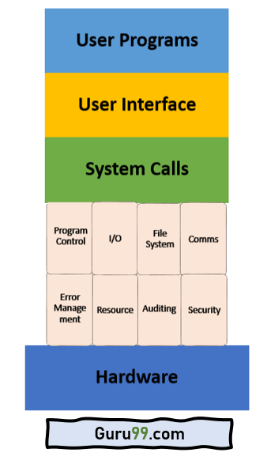
System Calls

Slide 5
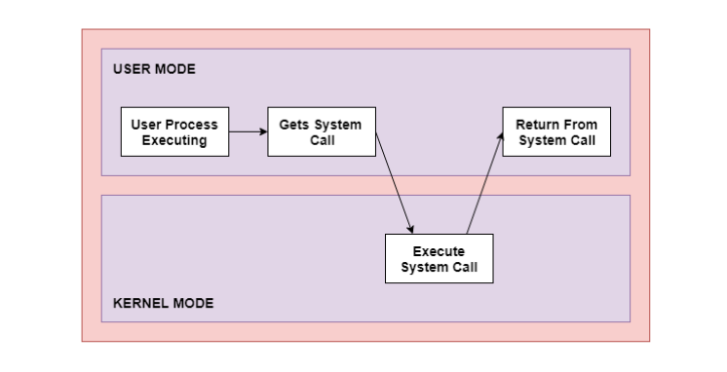
System Calls
How System Call Works

Slide 6
System Calls
How System Call work
As you can see in the above-given System Call example diagram.
Step 1) The processes executed in the user mode till the time a system call interrupts it.
Step 2) After that, the system call is executed in the kernel-mode on a priority basis.
Step 3) Once system call execution is over, control returns to the user mode.,
Step 4) The execution of user processes resumed in Kernel mod

Slide 7
System Calls
Why We need System Calls
Following are situations which need system calls in OS:
Reading and writing from files demand system calls.
If a file system wants to create or delete files, system calls are required.
System calls are used for the creation and management of new processes.
Network connections need system calls for sending and receiving packets.
Access to hardware devices like scanner, printer, need a system call.

Slide 8
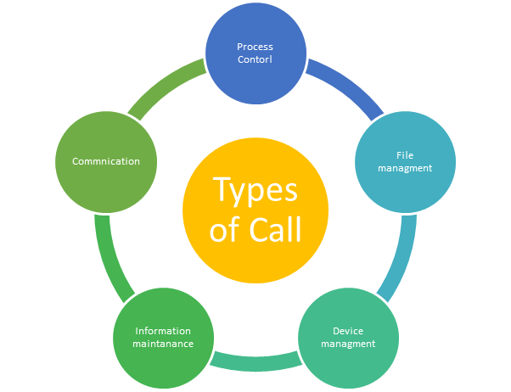
System Calls
Types of System Calls
Here are the five types of System Calls in OS:
Process Control
File Management
Device Management
Information Maintenance
Communications

Slide 9
System Calls
Process Control
This system calls perform the task of process creation, process termination, etc.
Functions:
End and Abort
Load and Execute
Create Process and Terminate Process
Wait and Signal Event
Allocate and free memory

Slide 10
System Calls
File Management
File management system calls handle file manipulation jobs like creating a file, reading, and writing, etc.
Functions:
Create a file
Delete file
Open and close file
Read, write, and reposition
Get and set file attributes

Slide 11
System Calls
Device Management
Device management does the job of device manipulation like reading from device buffers, writing into device buffers, etc.
Functions:
Request and release device
Logically attach/ detach devices
Get and Set device attributes

Slide 12
System Calls
Information Maintenance
It handles information and its transfer between the OS and the user program.
Functions:
Get or set time and date
Get process and device attributes

Slide 13
System Calls
Communication
These types of system calls are specially used for inter process communications.
Functions:
Create, delete communications connections
Send, receive message
Help OS to transfer status information
Attach or detach remote devices

